Slide 1
Agile Planning
Dirk Riehle, FAU Erlangen
AMOS B04
Licensed under CC BY 4.0 International

Slide 2
Final Reminder About Common Mistakes
Product owners, please don’t forget to take turns
Please sign-off your commits and declare your co-authors, if any
During sprint review, please show and tell, not just tell
Don’t forget your next sprint preparation meeting

Slide 3
Agenda
Product goal
Product glossary
Product backlog
Sprint planning
Release planning
Definition of done
Roadmapping

Slide 4
1. Product Goal

Slide 5
Product Goal [1]
The product goal is
The purpose of undertaking the project
To resolve the product / project conflict, AMOS separately defines
Product vision and project mission
[1] Introduced only in the Scrum 2020 guide

Slide 6
Product Vision
The product vision is the
Timeless reason why the software under development should exist
The product vision should contain a sustainability model
Business value of why someone pays for the development
The Flowers social network helps flower enthusiasts worldwide to connect with each other and enjoy following their favorite hobby online. Centered on showing and rating favorite flower photos, it inspires growing and presenting ever more beautiful flowers. With a highly engaged user community, Flowers is the best place for producers and sellers of gardening supply to reach out to customers and engage with them. Such engagement involves understanding flower enthusiasts’ needs around gardening supplies and selling to them.

Slide 7
Project Mission
The project mission is
What the team has committed to achieving within the given project time-frame
The mission of this project is to create an MVP for Wahlzeit with the Flowers extension. Core functionality will be showing and rating photos, basic user management, case management, and minimal system administration.

Slide 8
One-Time Deliverable: Product Vision and Project Mission
Please discuss and agree on product vision and project mission
If necessary, update vision and mission during the project

Slide 9
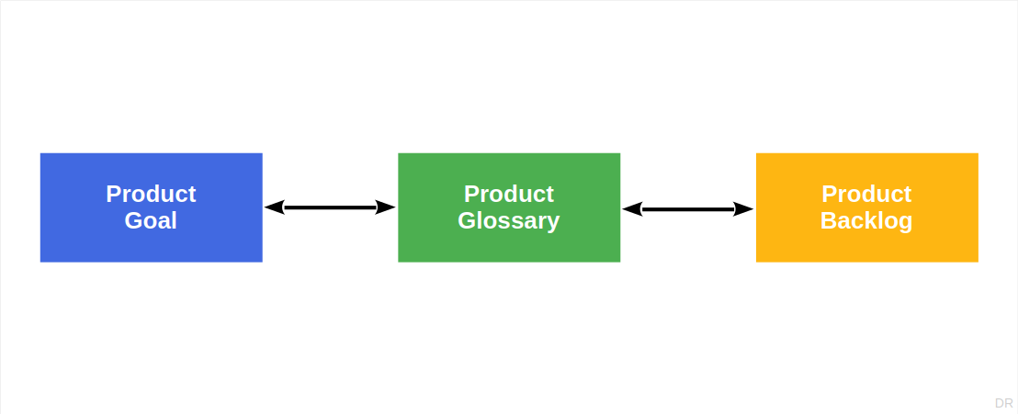
Product Goal / Product Glossary / Product Backlog

Slide 10
2. Product Glossary

Slide 11
Product Glossary
A product glossary is a
List of domain concept (term) definitions
Domain concepts can be
Original concepts, synonyms (links), shorthands, …
A glossary is a poor man’s approach to a domain model
Lack of formality doesn’t necessarily make it easier
The domain is the application domain

Slide 12
Example Domain Glossary
Term | Definition
Photo | A photo is an image uploaded by a user for display as part of the user’s photo portfolio
Photo rating | A short-hand for either individual or community photo rating
Individual photo rating | An integer value of 1..10 that a user gives to a photo shown to them
Community photo rating | A rational value of 1..10 that is the average of all individual photo ratings
Photo status | The status of a photo within the Wahlzeit system (uploaded, published, etc.)

Slide 13
Common Mistakes and Best Practices
Common mistakes
Lack of precision
Confusing application with technical domain
Redundant definitions
Best practices
Work from first principles i.e. “is a” (supertypes)
Avoid redundancy by building terms on each other
Make terms mutually exclusive, completely exhaustive (MECE)

Slide 14
Regular Deliverable: Product Glossary
Please create a product glossary and keep it up-to-date

Slide 15
3. Product Backlog

Slide 16
Scrum Backlogs
A backlog is a
Prioritized list of items that need doing
The product backlog is a backlog of items that
Are expected of the software under development
The sprint backlog is a backlog of items that
Are marked for doing in the upcoming sprint
The impediments backlog [1] is a backlog of items that
Are impediments to resolve and improvements to make
[1] Called imp-squared (impediments x improvements) backlog in AMOS

Slide 17
Backlogs and Backlog Items
Backlog items are items in a backlog
Product backlog → product backlog items
Sprint backlog → sprint backlog items
Impediments backlog → impediments x improvements

Slide 18
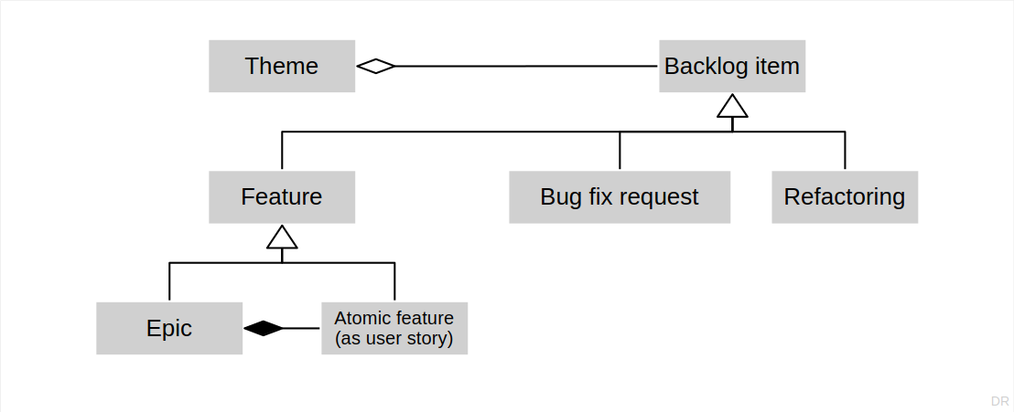
Types of Backlog Items [1] [2]
[1] If you are using Jira, backlog items are also called “tickets”
[2] There can be more types of backlog items, for example, “spikes”

Slide 19
Features, Refactorings, and Bug Fix Requests
A feature is
A distinguishing characteristic of a software item [IEEE 829]
A refactoring is
A behavior-preserving code transformation to improve code quality
A bug fix request is
A bug report where the bug is to be fixed against the underlying feature

Slide 20
Epics and User Stories
An epic is
A large feature awaiting break-down into smaller features
A placeholder for these smaller features
A user story is
A feature presented using a the user-story-pattern that is
Small enough to be implemented in a sprint

Slide 21
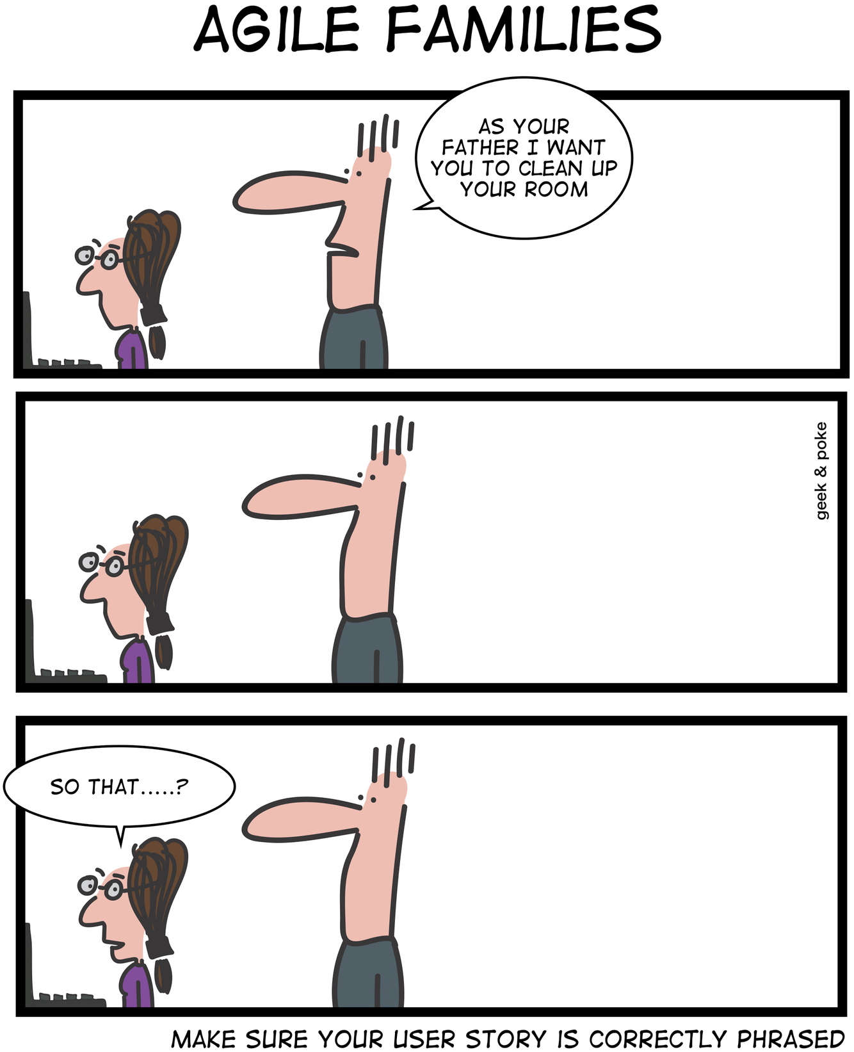
User Stories
A user story is a feature described using a pattern of
As a [user role]
I need a [function] so that
I get [business value]
User stories are discussion starters, not specifications
Tell-a-Friend: As a Flowers user, I need a function to tell a friend about a flower photo, so that I can share my passion for flowers and increase my network.

Slide 22
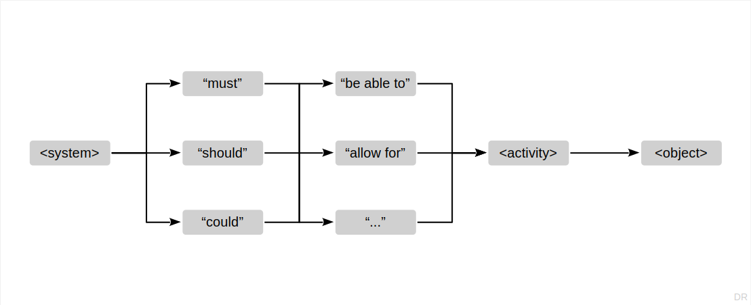
Common Alternative to User Stories

Slide 23
Quality Criteria for Backlog Items
I | ndependent: Items should be independent of each other
N | egotiable: An item can be questioned and revised
V | aluable: An item should have recognizable business value
E | stimatable: An item should be sufficiently precise to estimate a size
S | mall: An item should be small enough to fit into one iteration
T | estable: An item should have testable success criteria

Slide 24
Acceptance Criteria
An acceptance criterion for a backlog item is
A proposition that must be true before the item can be accepted
Acceptance criteria are the list of required propositions
Acceptance criteria are specific to the backlog item
Acceptance criteria are written by the product owner

Slide 25
Story Points
Story points
Is an arbitrary numeric measure of size of a given backlog item
Properties
Is a measure of size, not of effort or duration
Measured in non-linear increments, forcing choice
Is socially agreed upon, depends on team estimation history
Is independent of a particular person (and their skills)
Is mapped to time using the team's velocity (development speed)
Points | Meaning
0 | No size
1 | Trivial size
2 | Small size
3 | Medium size
5 | Large size
8 | Very large size
13 | Too large (size)

Slide 26
Size vs. Effort
Size is
An estimate of complexity
Measured in an arbitrary unit
Does not depend on people
Effort is
An estimate of duration
Measured in person hours
Depends on the implementer

Slide 27
Prioritization by Dependency
Backlog items must precede their dependent backlog items
# | Name | User story
1 | Registration | As a visitor, I would like to create an account, to be known to the system
2 | Login | As a user, I would like to log-in, so that I can access my account
3 | Logout | As a logged-in user, I would like to log-out, to be anonymous again
4 | Profile update | As a logged-in user, I would like to update my profile (name, photo, email)

Slide 28
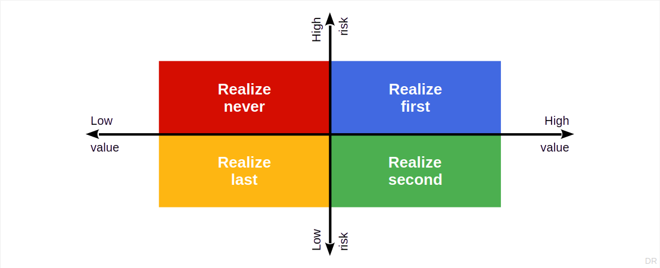
Prioritization by Risk / Value

Slide 29
Product Backlog Items vs. Tasks
Product backlog items are
Written by a product owner
Business-value-oriented
Product backlog items can be broken down into tasks
Tasks are
Written by a software developer
Implementation-oriented

Slide 30
4. Sprint Planning

Slide 31
Sprint Duration
Sprints are
Same-duration time-boxes that deliver a useful increment of value
Realistic durations in practical use
One-week durations (like AMOS, but less common)
Two-week durations (most common sprint duration)
One-month durations (in use, but too long for some)
Six-months durations (not really agile any longer)

Slide 32
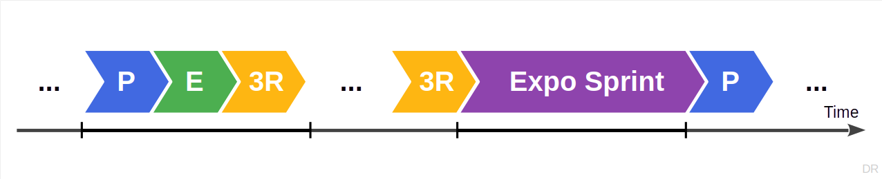
Types of Sprints
Regular sprints
Exploratory sprints
Cleanup sprints
Release sprints

Slide 33
Sprint Planning
In the run-up to sprint planning, the product owner
Proposes a sprint goal
Prepares the product backlog
During sprint planning, the Scrum team
Agrees on the sprint goal
Plans as discussed before

Slide 34
Sprint Goal
The sprint goal is
The purpose of the sprint (crisply formulated)
The product owner proposes it, but
The developers agree and commit to it
The sprint goal discussion is the first part of sprint planning

Slide 35
Regular Deliverable: Sprint Goal
Please agree on a sprint goal during sprint planning
Add your sprint goal to your planning document

Slide 36
Velocity (Development Speed)
v = s / t
(Story points per sprint)
v = velocity (speed)
s = size (of feature)
t = time (in sprints)

Slide 37
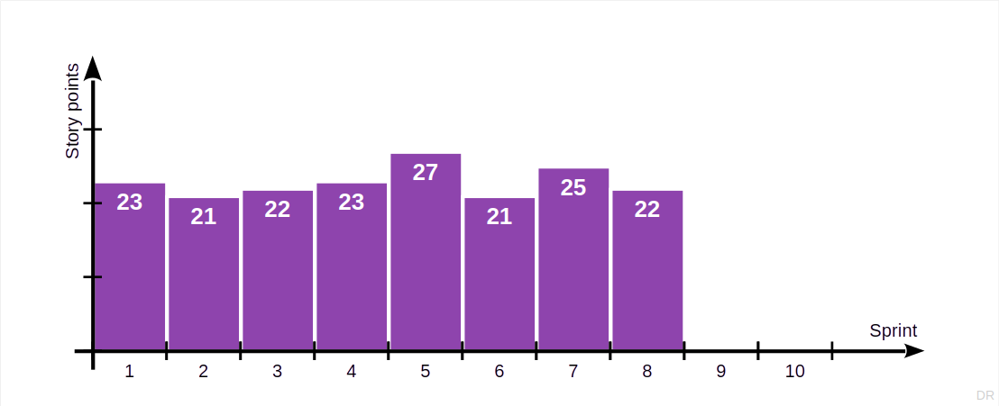
Charting Velocity

Slide 38
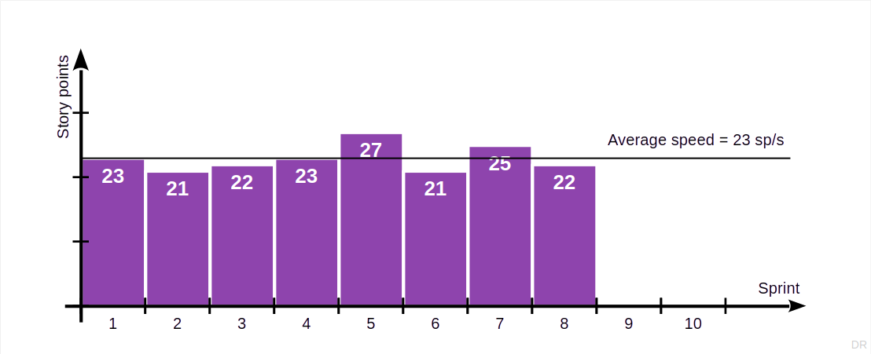
Measuring Average Speed for Sprint Planning

Slide 39
Who “Owns” the Velocity Calculation and Chart?
Product owner
Needs it to create release plans
Scrum Master
Wants it to track process improvement

Slide 40
5. Release Planning

Slide 41
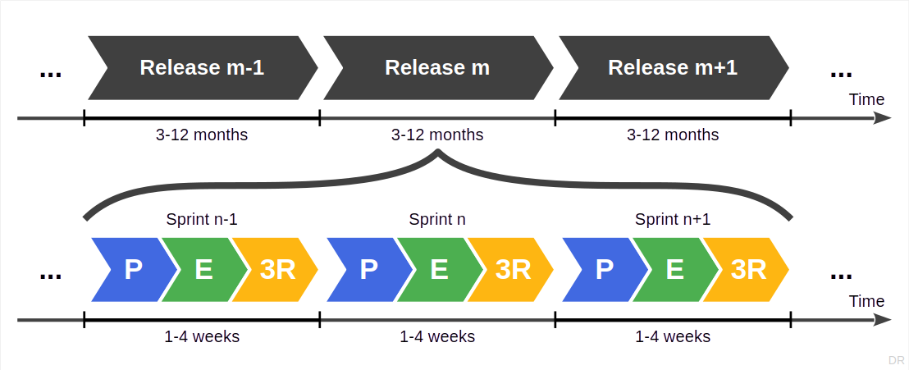
Software Development as a Sequence of Releases

Slide 42
Example of a Project / Product Release Plan
Sprint | Goal | Feature Name | Est. Size | Est. Remaining | Real Size | Real Remaining
1 | Deliver first increment of running software |  | 21 | 63 | 21 | 63
2 | Deliver increment with basic user handling |  | 21 | 42 | 23 | 42
3 | Deliver increment with basic photo handling |  | 21 | 21 | 0 | 19
4 |  |  |  | 0 |  | 19
Features
1 | Deliver first increment of running software
 |  | Register | 8 |  | 8
 |  | Login | 5 |  | 5
 |  | Logout | 3 |  | 3
 |  | Reset Password | 5 |  | 5
2 | Deliver increment with basic user handling
 |  | Prompt Basic Profile | 5 |  | 5
 |  | Change Basic Profile | 5 |  | 5
 |  | Change Password | 3 |  | 5
 |  | Upload Photo | 8 |  | 8
3 | Deliver increment with basic photo handling
 |  | Browse Photo Portfolio | 8
 |  | Select Photo | 5
 |  | Change Photo Data | 3
 |  | Delete Photo | 5

Slide 43
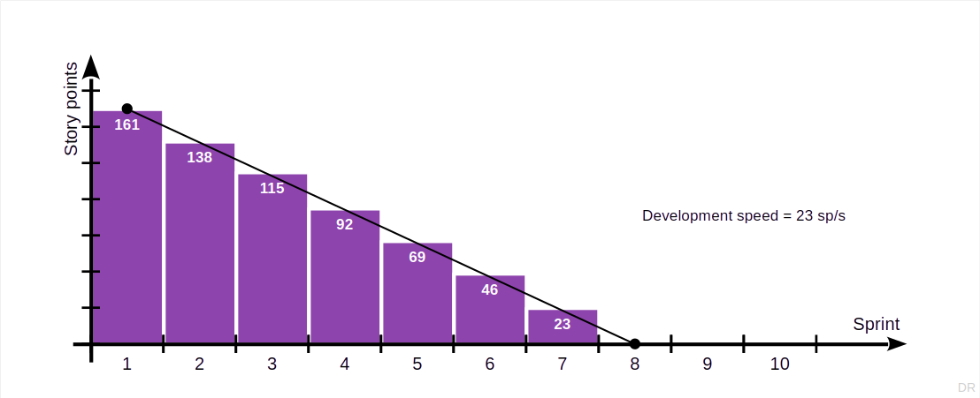
Burn-down to Project / Product Release (Burn-down Chart)

Slide 44
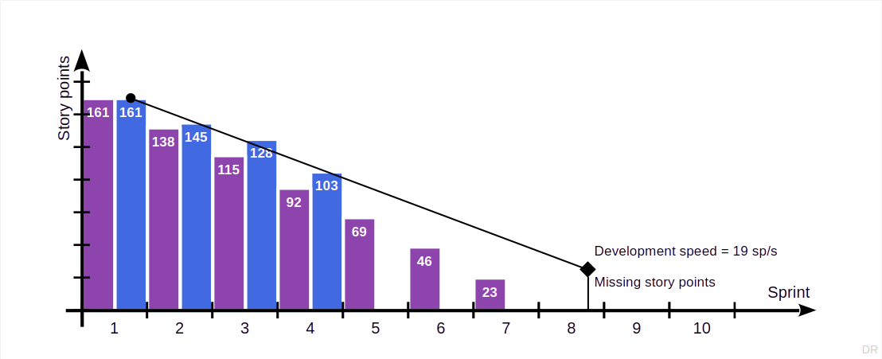
Estimated vs. Real Burn-Down

Slide 45
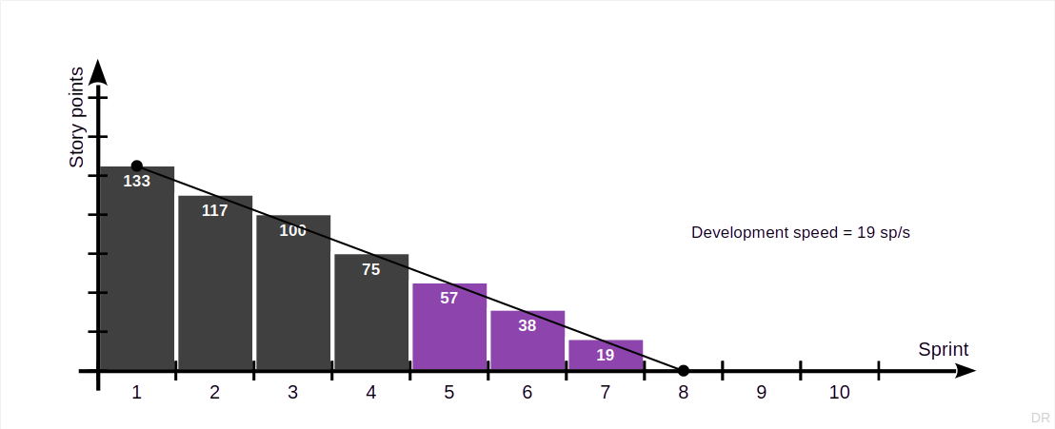
Adjusting the Release Plan to Reality

Slide 46
Who “Owns” the Release Plan and Burndown Chart?
Product owner
Needs it to predict work and prioritize accordingly
Scrum Master
Wants it to track process improvement

Slide 47
Regular Deliverable: Project Release Plans
Please create a mid-project and final release plan and keep them updated
(The initial version of the final release plan is due only after the mid-project release.)

Slide 48
6. Definition of Done

Slide 49
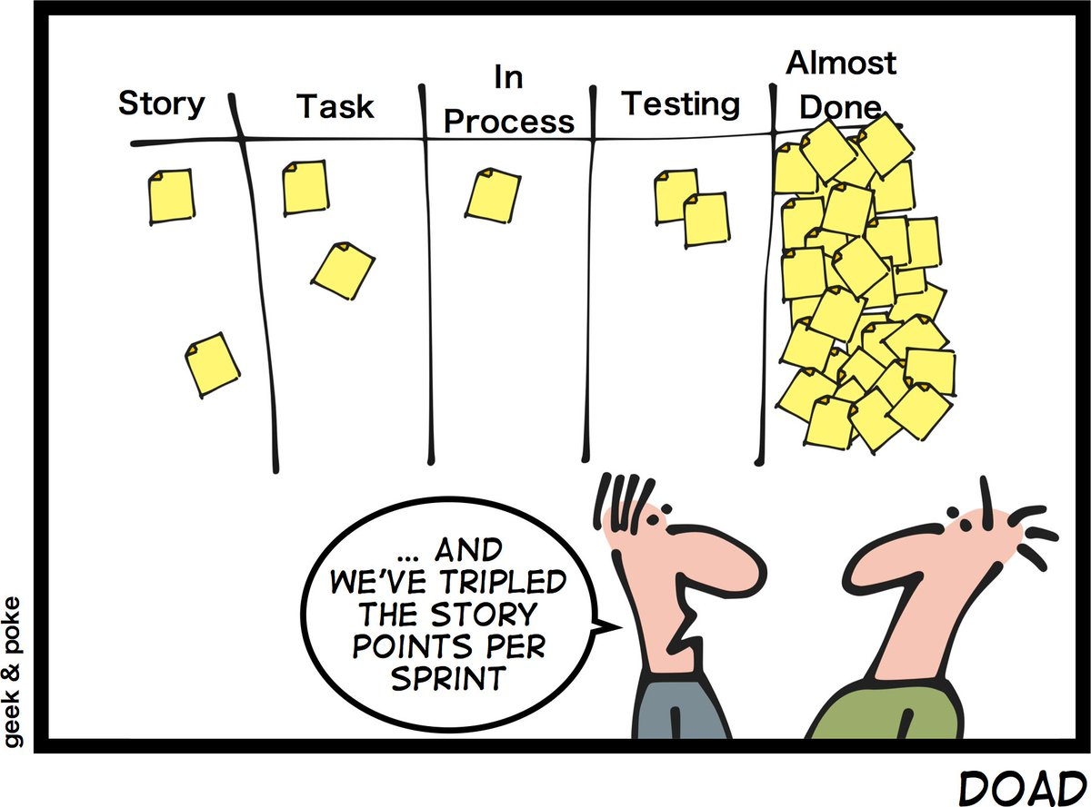
Almost Done …

Slide 50
Definition of Done
A definition of done (DoD) is
An auditable check-list of propositions about an artifact
Shared by all artifacts of the same type
Typically of a technical nature
Assessing whether the artifact is “done”
DoDs help ensure a consistent quality of the artifact

Slide 51
Decisions Utilizing Definitions of Done
There are three main decisions with associated definitions of done
Feature
Sprint release
Project release
In contrast, to feature definitions of done, acceptance criteria are
Specific to each backlog item
Typically of an application domain nature

Slide 52
Example Definition of Done for Features
Component tests have been written and pass
Code review has been completed and code has been merged
All feature branches have been merged and closed
New feature code has been documented

Slide 53
Example Definition of Done for Sprint Release
Project builds, deploys, and tests successfully
Database update scripts succeed, consistency tests pass
Sprint release notes have been written
Change log has been updated

Slide 54
Example Definition of Done for Project Release
User interaction tests pass on all major browsers
Component test coverage is above 70%
Design documentation has been updated
User documentation has been updated

Slide 55
One-Time Deliverable: Definitions of Done
Please discuss and agree upon definitions of done for all three types
Feel free to strengthen the definitions of done over time

Slide 56
7. Roadmapping

Slide 57
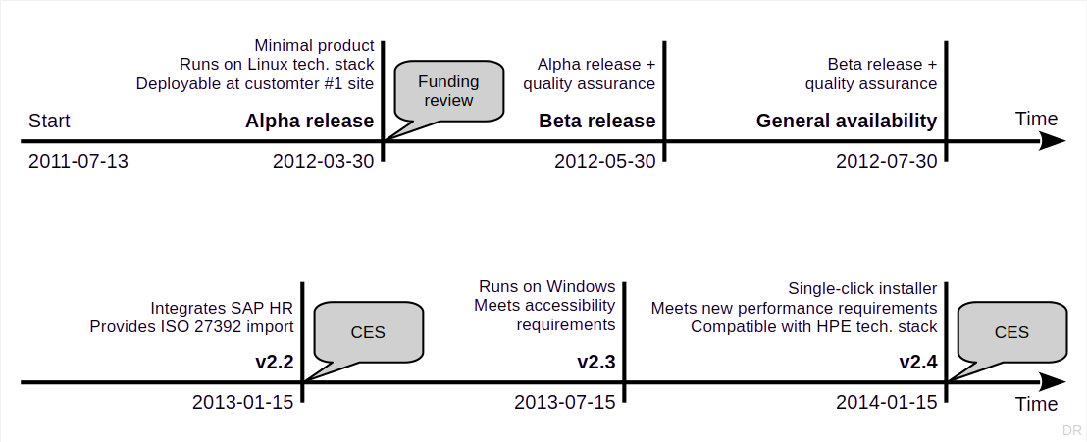
Illustration of Example Roadmap

Slide 58
Time Horizons of Planning Concepts
 | Time-frame | Content | Certainty | Owner
Product vision | Long-term (3+ years) | High-level ideas | Low | CEO / business owner
Product roadmap | Medium (1-5 years) | Themes and epics | Medium | (Strategic) product manager
Product or project release | Short-term (months) | Epics and features | High | Scrum product owner

Slide 59
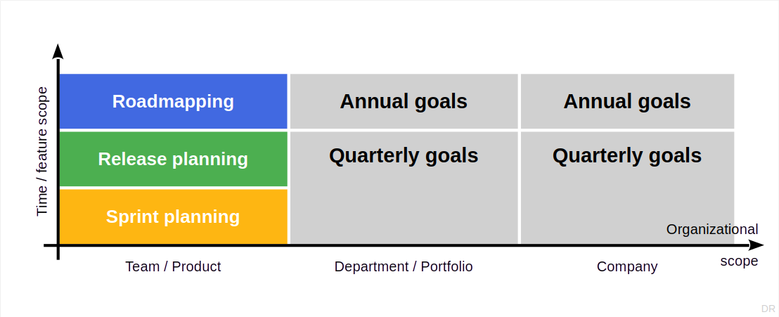
Planning vs. Organizational Scope

Slide 60
Summary
Product goal
Product glossary
Product backlog
Sprint planning
Release planning
Definition of done
Roadmapping

Slide 61
Thank you! Any questions?
dirk.riehle@fau.de – https://oss.cs.fau.de
dirk@riehle.org – https://dirkriehle.com – @dirkriehle

Slide 62
Legal Notices
License
Licensed under the CC BY 4.0 International license
Copyright
© Copyright 2009-2025 Dirk Riehle, some rights reserved

